Slide 1


WEKA
BY
SONY REDDY
SHREYA SINGH
MAHIMA VERMA
PARTHIBAN

Slide 2
INTRODUCTION OF WEKA
WEKA – Waikato Environment for Knowledge Analysis
Collection of machine learning algorithms for data mining task.
Fully implemented in Java Programming language.
Features
- 49 Data preprocessing tools
- 76 Classification algorithms
- 8 Clustering algorithms
- 15 Attribute evaluators

Slide 3

INTERFACES
Main GUI
- The Explorer (exploratory data analysis)
- The Experimenter (experimental environment)
- The Knowledge flow(new process model interface)
Simple CLI
- Recommended for in-depth usage.
- Offers more functionality that are not available in GUI.

Slide 4
The explorer
Data preprocess
Classification
Clustering
Association rules
Attribute selection
Data visualization

Slide 5
ARFF file format
External representation of instance of class.
Should includes
- Dataset name
(preceded by @relation)
- Attributes
(preceded by @attribute)
- Data values
(separated by commas)

Slide 6
Data classification
Bayes
P(H|E) = P(E|H) * P(H)/P(E)
P(H|E) Is posterior probability when evidence is know
Bayesian network
Where evidences are dependent on each other
P(H|E₁, E₂, E₃,…, E_{n}) = P(E₁, E₂, E₃,…, E_{n}|H) * P(H)/P(E₁, E₂, E₃,…, E_{n})
Naïvebayes classifier
Many evidences support occurrence of event where evidences are independent of each other.
P(H|E₁, E₂, E₃,…, E_{n}) = P(E₁|H) * P(E₂ |H) * ….* P(E₁|H) * P(H)/P(E₁, E₂, E₃,…, E_{n})

Slide 7
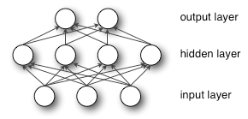
DATA CLASSIFICATION
Functions
- Multilayer Perceptron (MLP)
a) Feed forward connection between pairs of adjacent layers.
b) Continuous and differential activation functions.
c) Realize a multi-dimensional functional y = Ø(x) between input X € R^{d}i and output Y € R^{d}o .
d) Backpropagation.
e_{j}(n) = d_{j}(n) – y_{j}(n).

Slide 8
Data classification
Lazy:
K-star (nearest neighbor algorithm)
a) K ← number of nearest neighbor
b) for each object X in the test set do
calculate the distance D(X,Y)
neighborhood ← the k neighbors in training set closest to X
X.class ← SelectClass(neighborhood)
c) end for

Slide 9
Meta
Bagging:
Bootstrap:
Create a random subset of data by sampling.
Draw N’ of the N samples with replacement.
•Bagging:
Repeat K times.
Create a training set N’ < N.
Train a classifier on the random training set.
To Test, run each trained classifier.
Each classifier votes on the output, majority
For regression: each regressor predicts, take average.

Slide 10
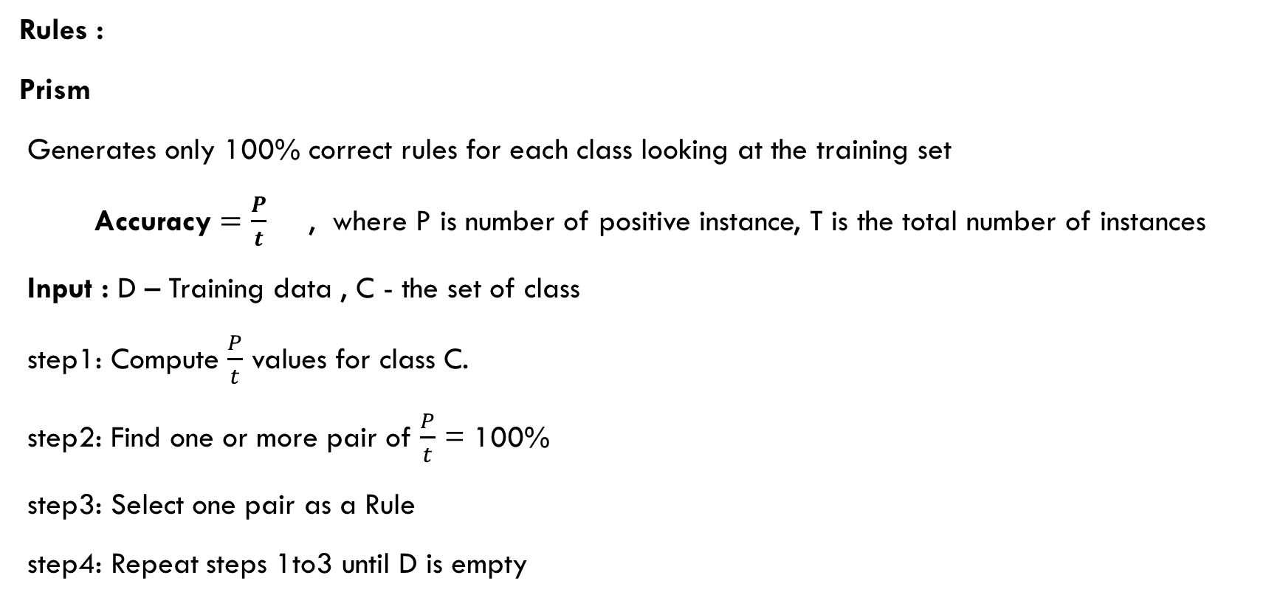
DATA CLASSIFICATION
Rules :
Prism
Generates only 100% correct rules for each class looking at the training set
Accuracy $=\frac{P}{t}$ , where P is number of positive instance, T is the total number of instances
Input : D – Training data , C - the set of class
step1: Compute $\frac{P}{t}$ values for class C.
step2: Find one or more pair of $\frac{P}{t}$ = 100%
step3: Select one pair as a Rule
step4: Repeat steps 1to3 until D is empty

Slide 11
Data classification
Trees
J48 : implementation of C4.5 algorithm
Input: Training Data
Output: Decision tree
Information gain I(n) = ∑ (n * log₂ n)
Evaluates Normalized information gain for all class from the training set.
Attribute with Highest information gain is used for splitting the data.
Splitting stops if all instances in a subset belong to the same class.
Attribute with Highest value of information gain is considered as first split criteria (root node) and successive will be its leaf nodes.

Slide 12
clustering
K-Mean algorithm
Widely used partition based clustering method
Efficient one in terms of execution time
Input:
K number of clusters,
D dataset of n objects
Output: Set of K clusters
Method:
a) arbitrarily choose k objects from D as cluster center
b) repeat
c) Reassign each object based on mean value in cluster
d) update the cluster means
e) until no change.

Slide 13
Association rules
Apriori algorithm
F_{l} = (frequent itemsets of cardinality 1);
for(k=1;F_{k} ≠ Ø;k++)do begin
C_{k+1} = apriori-gen(F_{k} );
for all transactions t € Database do begin
C’_{t =} subset(C_{k+1} , t);
for all candidate c € C’_{t} do
c.count ++;
end
F_{k+1} = { C € C_{k+1} | c.count ≥ minimum support }
end
end
Answer U_{k}F_{k}

Slide 14


Slide 15


